Slide 1
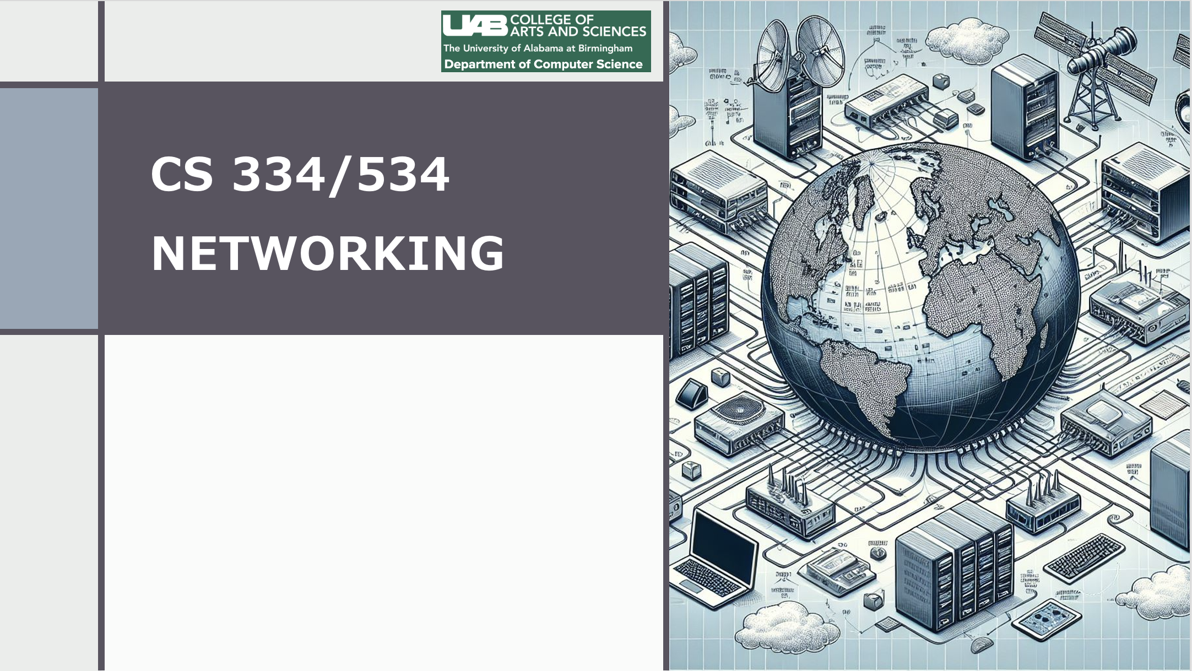
Dr. Ragib Hasan
Lecture 5.2:
IP Fragmentation and IP addresses

Slide 2
IP fragmentation
IP packets can be fragmented if the minimum packet size of the underlying Link layer (LAN) is smaller.
It needs to support networks where the maximum packet size, or Maximum Transfer Unit (MTU), is smaller than the packet that needs forwarding.
Example: A Token ring network (MTU=4kB) to an Ethernet (MTU=1500B).

Slide 3
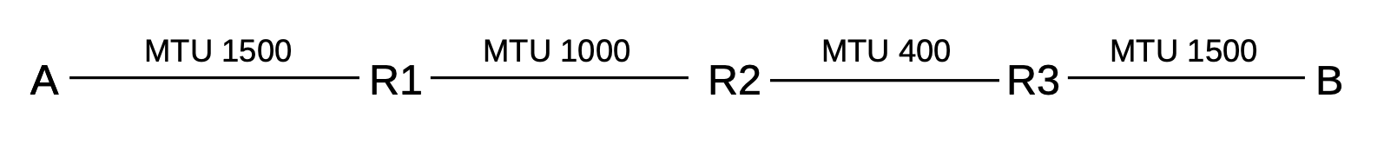
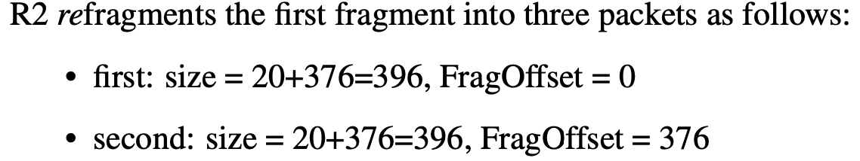

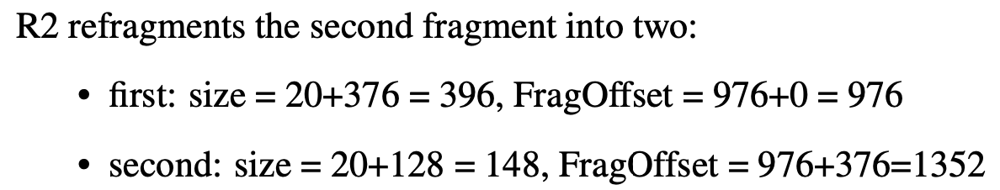
Example
A sends a packet (20 byte header, 1480 byte data)
R1 fragments the original packet into two packets of sizes 20+976 = 996 and 20+504=524.

Slide 4
IP Packet Options
Up to 10 words are available for storing options
Example options:
record route: intermediate routers store their IP address into the packet
Timestamp: intermediate routers can put the timestamp
Source routing: Sender specifies preferred route

Slide 5
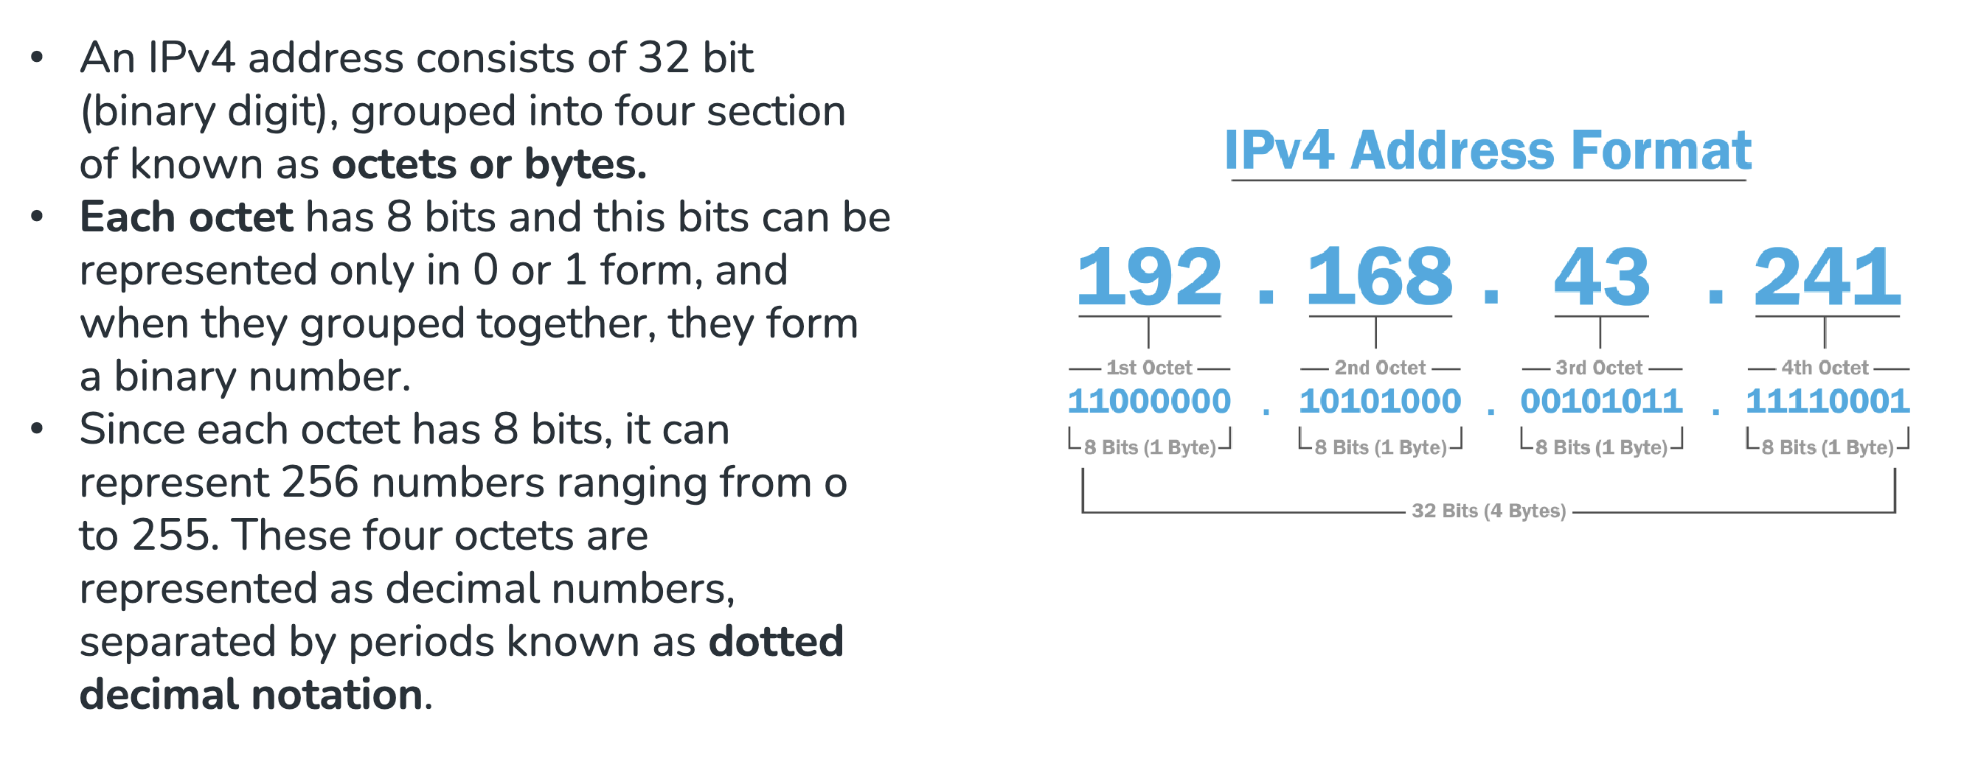
IP address
Recap from lecture 2.1

Slide 6
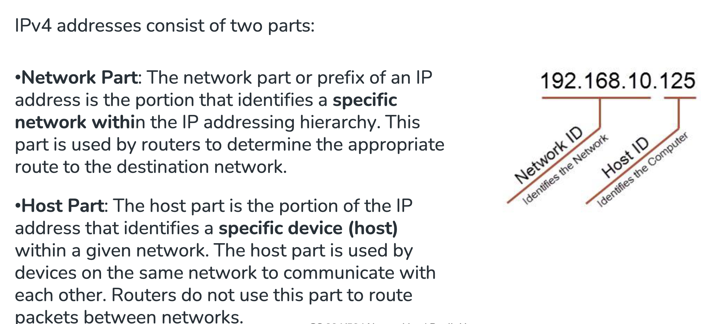
IP Address
Recap from lecture 2.1

Slide 7
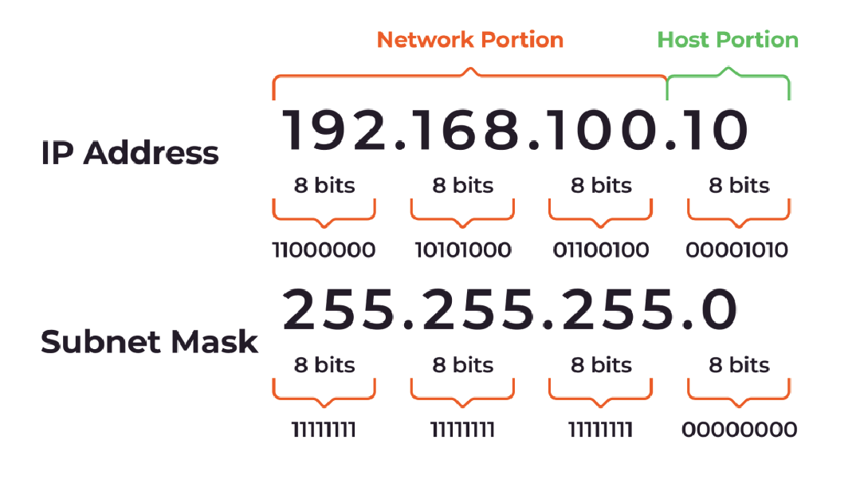
IP subnet mask
Recap from Lecture 2.1
For 192.168.100.10/24, the subnet mask would be 255.255.255.0.
This means that the first 24 bits are used for the network part, and the remaining 8 bits are used for the host part.

Slide 8
Who does the IP address belong to?
Technically, the IP address is associated with an interface, NOT directly to a host
A server with multiple network cards and connection will have a separate IP address for each interface
For example, eth0 is typically the short name for the Ethernet card. For multi-homed servers, there can be a second Ethernet card with the name eth1
Every host also have a loopback interface that points to itself. (Not a real ethernet card, but rather an abstract way of self-reference)
The address 127.0.0.1 or the name localhost is associated with the loopback interface (What’s the use of this?)

Slide 9
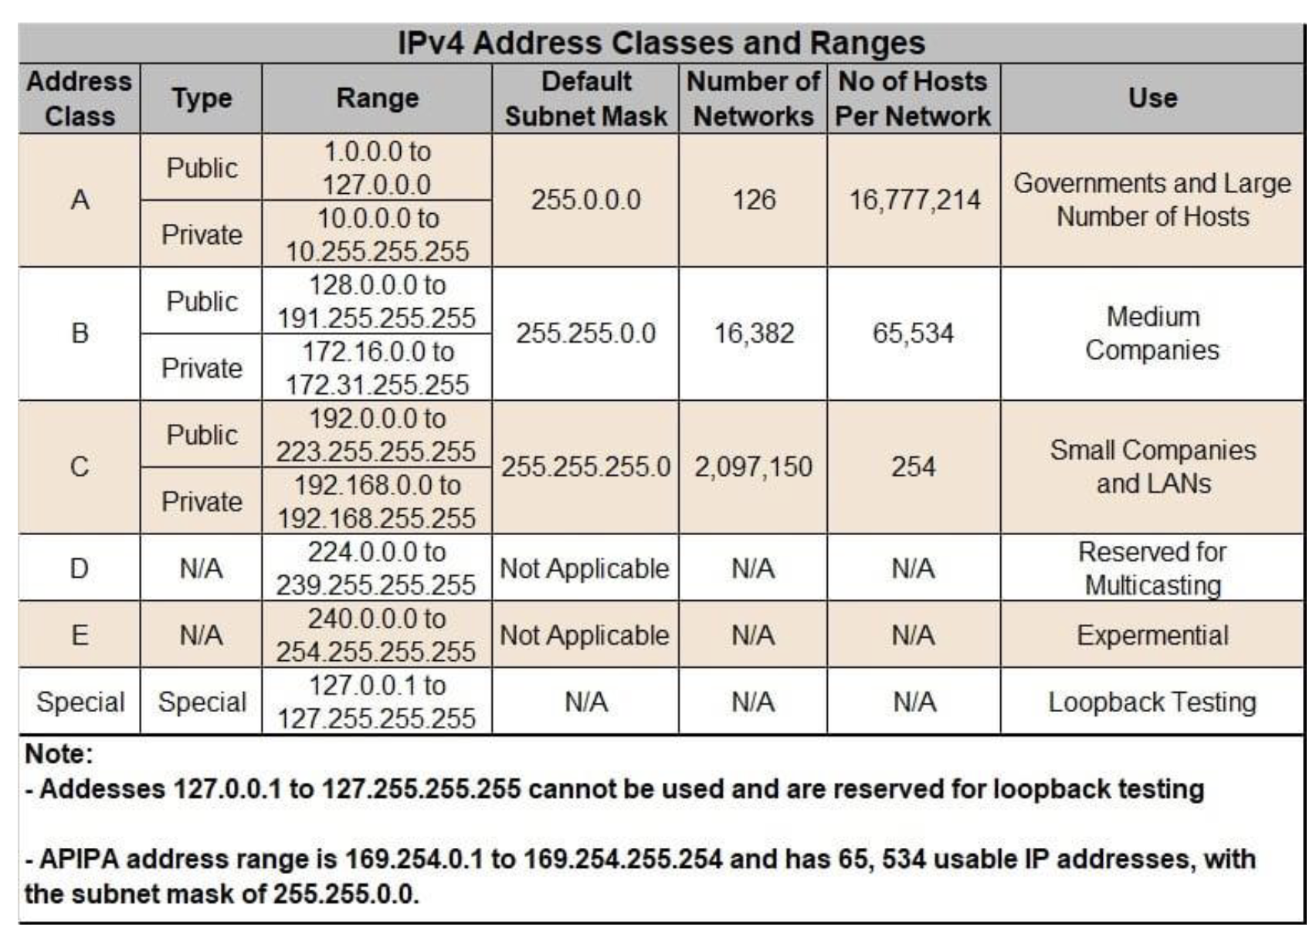
IPv4 classes
Recap from Lecture 2.1

Slide 10
Special IP addresses
127.0.0.1: Loopback interface
Private addresses: IPv4 addresses intended only for site internal use
10.0.0.0/8
172.16.0.0/12
192.168.0.0/16
Quick check: if you are on a laptop, try finding out your local IP address. In most cases, it would be in the format 192.168.*.*

Slide 11
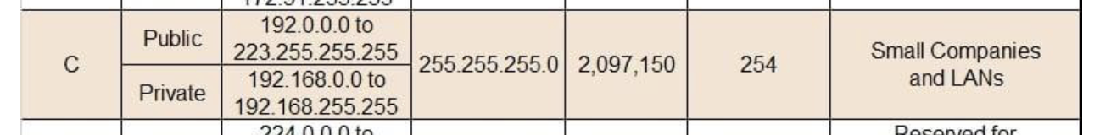
Special IP addresses
Broadcast address:
If all the host part bits are 1s, then it is a broadcast address for the network
For example, 192.168.0.255 will broadcast to all hosts with the network prefix 192.168.0.x
There is a catch – BSD unix used 0 bits for the broadcast address, so 192.168.0.0 would also be a broadcast address for the network
(Ever wondered why a class C network (/24) has 254 possible hosts instead of 256? Can you now explain that?)

